Slide 1

Address Verification
Address Verification

Slide 2
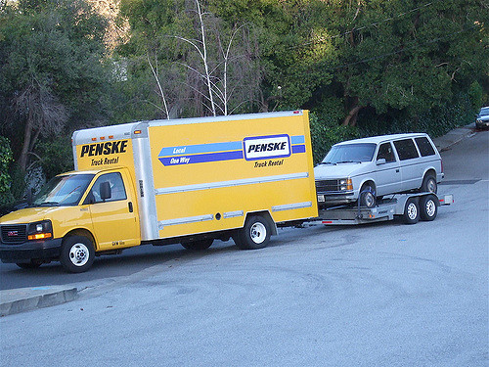
Change of address

Slide 3


Authorized Callers
Mentor: Demographic Changes for Medicare Overview, Who Can Request Demographic Changes, Member or Power of Attorney

Slide 4

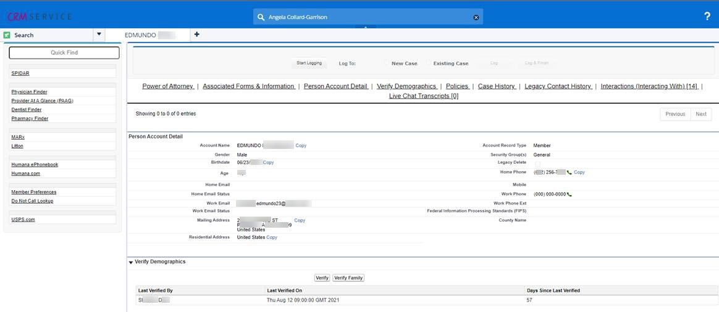
90 Day Address Verification

Slide 5

When address does not match?
Mentor: Updating LI NET Member Address and Telephone Number

Slide 6


Definitions
Mailing
Residential
Mailing
Residential
When CI PEDM Mailing/Residential field is filled out, it is the same location.

Slide 7

Navigate to CI PATR screen
Hod Mod 4 on Desktop
May be updated without verifying with CMS (MARx):
PAPI: Select (S) Active Package
Address
Type PATR on command line <enter>
Phone numbers
Create a task for existing member on PATR screen

Slide 8

Mentor:
Creating a Work Task on the PATR Screen

Slide 9



Creating a Task in PATR
  “If you don’t PATR it don’t matter” – Unknown
Accessing the the PEDM screen
  .
Updating the Address

Slide 10
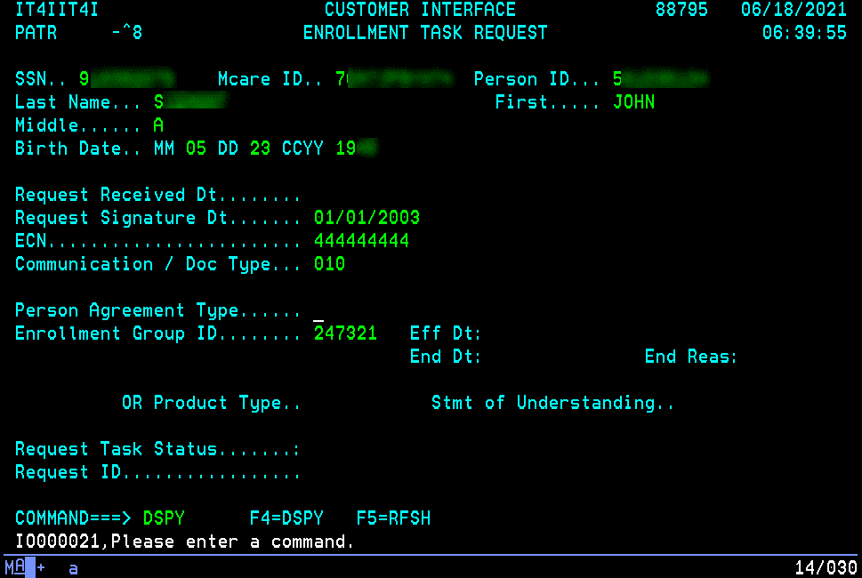

Creating a Task in PATR
Before updating an address you have to create a work task in PATR
  Insert the members MBI on the PAPI screen first then toggle over to the PATR screen.
  Fill out the appropriate fields:
    Request Signature Dt - 01/01/2003
    ECN- 444444444
    Communication / Doc Type – 010
    Enrollment Group ID – either:
      247318 (Non-NY)
      247321 (NY)
  Please be sure to pull process Creating a Work Task on the PATR Screen to make sure everything is entered correctly.
  Press F4
  PEMN screen displays and you will select the PEDM screen from the list
    Note: If the little angry man icon appears select the CTRL key to begin typing again.
Notes:
Member Used: John Siemont
Medicare ID: 7CA7JP9YH74

Slide 11
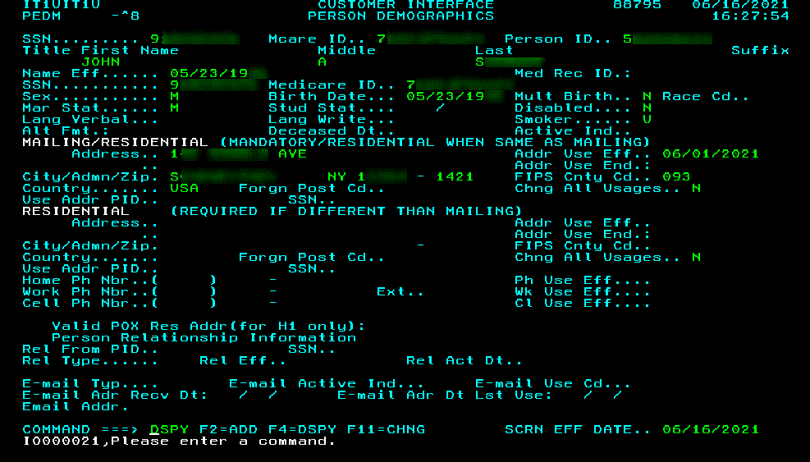

Changing the Address in the PEDM Screen
Verify with the caller their correct address and spelling
You will need to change the Address, Zip Code, FIPS County Code, City and State. All this information is located in the field highlighted.
Notate the updated address you are changing in your CRM notes
Notes:
Member Used: John Siemont
Medicare ID: 7CA7JP9YH74

Slide 12

Updating the Address
Key the correct information in the appropriate fields
To find the FIPS County Code:
Tab to the FIPS Cnty Cd field
Press F10
Choose the county within the zip
Press F4 to display
Press F9 to return to PEDM
Once all changes have been made press F11 you should then get a message at the bottom of the screen saying the changes were successful.
NOTE: Advise the member to contact their local Post Office to receive all forwarding mail at their new address. Also advise them to contact SSA/Medicare to update their address in those systems as well.

Slide 13
  Mentor Documents
  Creating a Work Task on the PATR Screen
  Updating LI NET Member Address and Telephone Number

Slide 14

Learning Center
CI 203305-Create Manual Task in PATR-eMOD

Slide 15
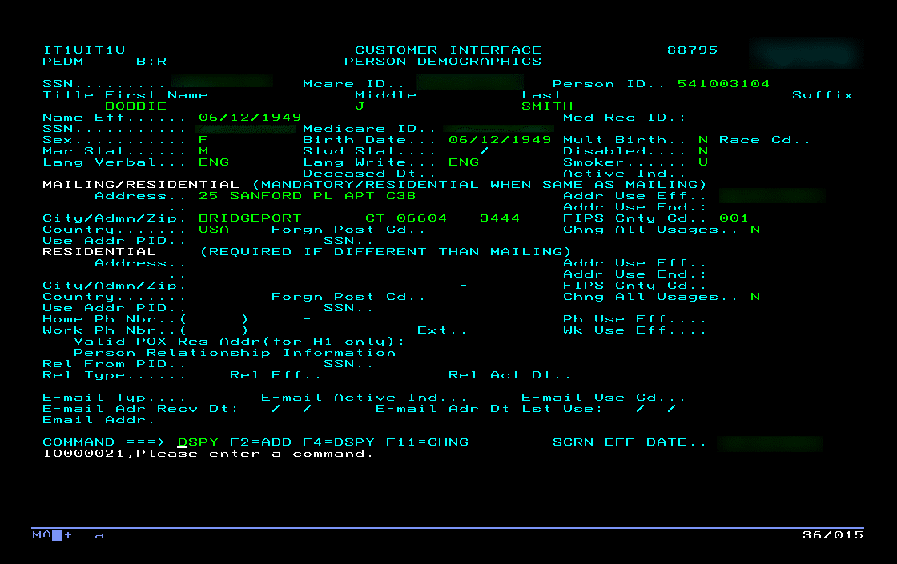
CI PEDM: Person Demographics Screen
Mentor: Medicare and Medicaid Address Entry Standards

Slide 16
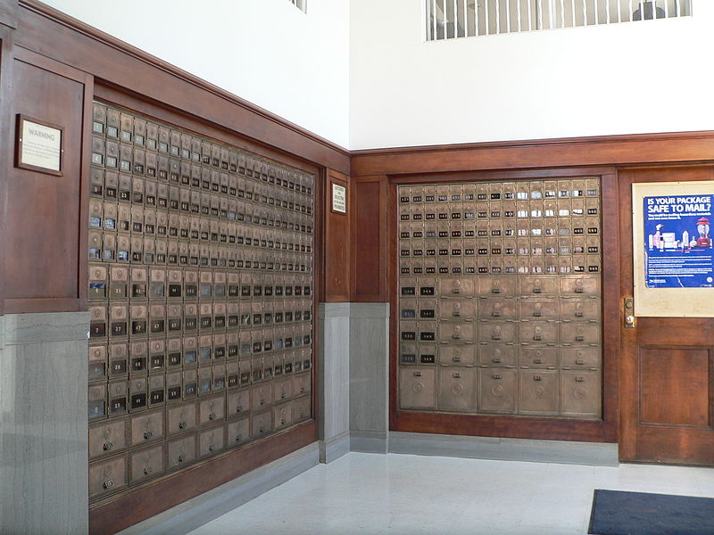
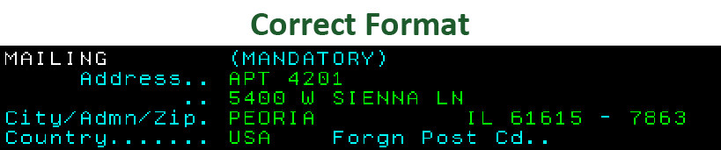
Remember:
Post Office Box
cannot be used as a
Permanent
Residential Address!

Slide 17

Q&A Session

Slide 18

Any temp moves OSA questions?

